Slide 1
Queuing System
Unit 3

Slide 2
Outline
Queuing system, Characteristics & Elements of Queuing Systems
Queuing discipline, Queuing Notations, Simulation of queuing system ,
Queuing models
Measures of System Performance
Application of Queuing system

Slide 3
Queuing system
A queueing system consists of one or more servers that provide service of some kind to arriving Customers
Queuing system are the waiting lines in which the system attribute are waiting for a service.
The queue may be of the customer waiting for the server or server waiting for customer.
If the servers are busy, the customers join one or more queues in front of the servers

Slide 4
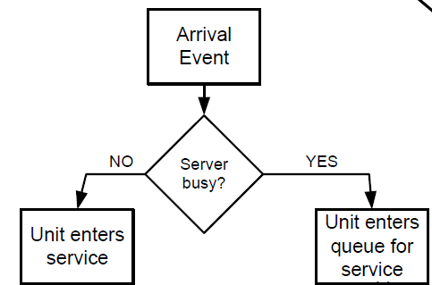
Queuing system
The line where the entities or customers wait is generally known as queue.
The combination of all entities in system being served and being waiting for services will be called a queuing system.
The general diagram of queuing system can be shown as a queuing system involves customers arriving at a constant or variable time rate for service at a service station.
Customers can be students waiting for registration in college, airplane queuing for landing at airfield, or jobs waiting in machines shop.

Slide 5
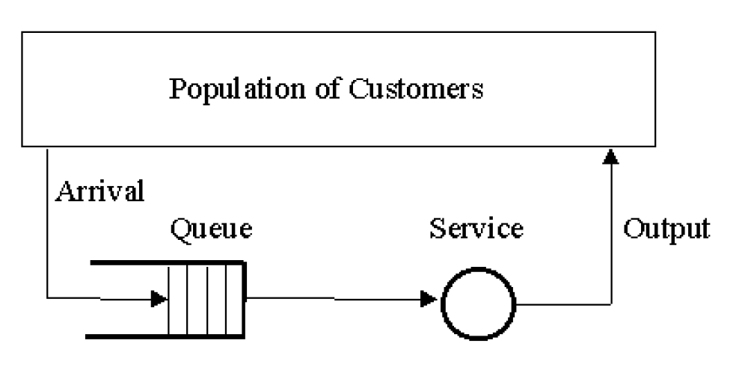
Queuing system
They remain in queue till they are provided the service. Sometimes queue being too long, they will leave the queue and go, it results a loss of customer.

Slide 6
Queuing system
The basic concept of queuing theory is the optimization of wait time, queue length, and the service available to those standing in a queue.
Cost is one of the important factors in the queuing problem.
Waiting in queues incur cost (to lose money), whether human are waiting for services or machines waiting in a machine shop. On the other hand if service counter is waiting for customers that also involves cost.
In order to reduce queue length, extra service centres are to be provided but for extra service centers, cost of service becomes higher.

Slide 7
Queuing system
A congestion system is system in which there is high demand for resources for a system, and when the resources become unavailable.
In queuing theory, traffic congestion is said to occur if the arrival rate into a system exceeds the service rate of the system at a point in time
Congestion occurs when number of server is insufficient and arrival rate exceeds capacity.

Slide 8
Characteristics of Queuing Systems
The key elements, of a queuing system are the customers and servers. The term "customer" can refer to people, machines, trucks, mechanics, patients— anything that arrives at a facility and requires service.
The term "server" might refer to receptionists, repairpersons, CPUs in a computer, or washing machines….any resource (person, machine, etc. which provides the requested service.

Slide 9
Queuing system
Queueing system includes; the server, the unit being serviced, and units in the queue.
Example of Queuing systems
System | Servers | Customers
Hospital | Doctors ,Nurses, Beds | Patients
Manufacturing Systems | Machines, Workers | Buyers, parts
Airport | Runways, Gates | Airplanes, Travelers
Cinema hall | counter
college
cafe

Slide 10
Characteristics of Queuing Systems
The calling population
The population of potential customers those requires service from the system
The arrival process (pattern)
Arrival may occur at scheduled times or at random times
Service process and service mechanism
Service process can be measured by the number of customers served per unit time. Once entities have entered to the system they must be served.
Queue behaviour and discipline
It is the rule that server uses to choose the next customer from the queue
Number of servers
Servers represent the entity that provides service to the customer. A system may consist of single server or multiple servers.

Slide 11
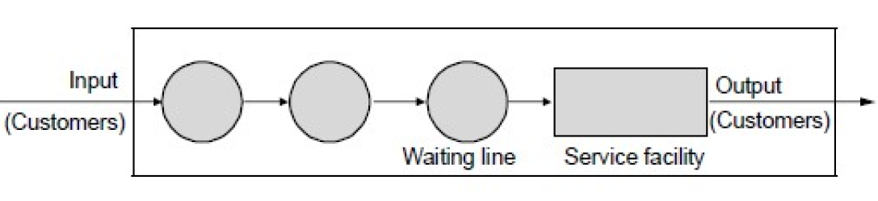
Elements of queuing system
Population of customers
Arrival
Queue or waiting line
Service time &service mechanism
output

Slide 12
Elements of queuing system
Population of customers
Customer are the entities who wants service from the server. It can be considered either limited (closed system) or unlimited (open system).
In systems with a large population of potential customers, the calling population is usually assumed to be finite (Closed System) or infinite (Open System). Examples of infinite populations include the potential customers of a restaurant, bank, etc.
The main difference between finite and infinite population models is how the arrival rate is defined.
In an infinite-population model, the arrival rate is not affected by the number of customers who have left the calling population and joined the queuing system.
On the other hand, for finite calling population models, the arrival rate to the queuing system does depend on the number of customers being served and waiting.

Slide 13
Elements of queuing system
2. Arrival
It defines the way that customer enter the system.
Mostly arrivals are random with random intervals between two adjacent parameters.
Arrivals may occur at scheduled times or at random times. When at random times, the inter arrival times are usually characterized by a probability distribution.
The arrival rate is the number of arrivals per unit of time.
arrival rate = 1/inter arrival time
The inter arrival time is the time between each arrival into the system and the next.
inter arrival time = 1/arrival rate

Slide 14
Elements of queuing system
For example;
If 12 customers enter a store per hour, the time between each arrival is;
.
inter arrival time = 1/arrival rate
= 1/12
= 0.083 (hours)
= 0.083 x 60 minutes
= 5 (minutes)
Therefore from the arrival rate of 12 per hour, the time between each arrival is 5 minutes

Slide 15
Elements of queuing system
Questions
If 30 customers enter a store per hour, the time between each arrival is;
If the inter arrival time of a store is 8 minutes, find the total number of customer entering a store.

Slide 16
Elements of queuing system
3. Queue or waiting line
It especially represents a certain number of customers waiting for service. Two important properties of queue are:
Maximum size
Maximum size is the maximum number of customers that may be waiting in a queue or the maximum capacity of server.
Queuing discipline
Common queue disciplines include first-in, first-out (FIFO); last-in first out (LIFO); service in random order (SIRO); shortest processing time first (SPT) and service according to priority (PR).

Slide 17
Elements of queuing system
4. Service times and service mechanism
It represents some activity that takes time and that the customers are waiting for. Theoretical models are based on random distribution of service duration also called service patterns.
System with one server is single channel system and with more servers in multichannel servers.
The service times of successive arrivals are denoted by S1, S2, S3, .. . They may be constant or of random duration.
Sometimes services may be identically distributed for all customers of a given type or class or priority, while customers of different types may have completely different service-time distributions.
Each service center consists of some number of servers, c, and working in parallel; that is, upon getting to the head of the line, a customer takes the first available server. Parallel service mechanisms are either single server (c = 1), multiple server (I < c < ∞), or unlimited servers (c = ∞).

Slide 18
Elements of queuing system
5. Output
Output represents the way customers leave the system.
Output is mostly ignored by theoretical models but sometimes the customers leaving the server enter the queue again.

Slide 19
Queuing discipline
It explains how the customer is solved by the server or the way in which queue is organized. It is the rule by which customer enters and exits the queue.
The queueing discipline describes in which order next entity is selected from the queue for service
Queue discipline refers to the logical ordering of customers in a queue and determines which customer will be chosen for service when a server becomes free.
Some queuing discipline are
FIFO – First In First Out
LIFO – Last In First Out
SIRO – Serial In Random Out
SPTF – Shortest Processing Time First
PR – Service According to Priority

Slide 20
Queuing discipline
Sometimes, the entity may leave the queue even before being served. Such process is known as ‘reneging’.
If an entity refuses to join the queue (because the queue is relatively long), the process is known as ‘balking’
If there are multiple lines i.e. queues but a single server, the entities are selected by the process of polling
In case of priority queue, if the recently arrived entity have the greatest priority, then the new arrival will interrupt or pre-empt (prevent) the service

Slide 21
Queuing Notation
Kendall’s notation is used for parallel server systems (Multiple Single Server). Kendall's Notation is a system of notation according to which the various characteristics of a queuing model are identified.
A notation used to characterize queueing systems.
The basic format of this notation is of form: A / B / s / q / c / P, where, A, B, s, q, c, P respectively indicate arrival pattern, service pattern, number of servers, queue discipline, system capacity, and Calling population.
Kendall classify a queuing notation system as 𝐴 / 𝐵 / 𝑠 / 𝑞 / 𝑐 / 𝑃
Where,
𝐴 𝑖𝑠 𝑡ℎ𝑒 𝐴𝑟𝑟𝑖𝑣𝑎𝑙 𝑝𝑎𝑡𝑡𝑒𝑟𝑛
𝐵 𝑖𝑠 𝑡ℎ𝑒 𝑆𝑒𝑟𝑣𝑖𝑐𝑒 𝑝𝑎𝑡𝑡𝑒𝑟𝑛
𝑠 𝑖𝑠 𝑁𝑜. 𝑜𝑓 𝑠𝑒𝑟𝑣𝑒𝑟
𝑞 is 𝑄𝑢𝑒𝑢𝑖𝑛𝑔 𝑑𝑖𝑠𝑐𝑖𝑝𝑙𝑖𝑛𝑒
c 𝑖𝑠 𝑆𝑦𝑠𝑡𝑒𝑚 𝑐𝑎𝑝𝑎𝑐𝑖𝑡𝑦
𝑃 𝑖𝑠 𝑃𝑜𝑝𝑢𝑙𝑎𝑡𝑖𝑜𝑛 𝑠𝑖𝑧𝑒

Slide 22
Queuing Notation
The symbols used for the probability distribution for inter arrival pattern, and service pattern are, D for deterministic, M for exponential (or Markov) and Em for Erlang.
Arrival and service pattern uses the following notations.
𝐷 − 𝐷𝑒𝑡𝑒𝑟𝑚𝑖𝑛𝑖𝑠𝑡𝑖𝑐 𝑜𝑟 𝑐𝑜𝑛𝑠𝑡𝑎𝑛𝑡 (no randomness is involved )
𝐺 − 𝐺𝑒𝑛𝑒𝑟𝑎𝑙 𝐷𝑖𝑠𝑡𝑟𝑖𝑏𝑢𝑡𝑖𝑜𝑛 (with no specific form but with a mean and variance.)
𝐺𝐼 − 𝐺𝑒𝑛𝑒𝑟𝑎𝑙 𝐷𝑖𝑠𝑡𝑟𝑖𝑏𝑢𝑡𝑖𝑜𝑛 𝑤𝑖𝑡ℎ 𝐼𝑛𝑑𝑒𝑝𝑒𝑛𝑑𝑒𝑛𝑡 𝑅𝑎𝑛𝑑𝑜𝑚 𝑉𝑎𝑙𝑢𝑒𝑠
𝑀 − 𝑃𝑜𝑖𝑠𝑠𝑜𝑛 (𝑀𝑎𝑟𝑘𝑜𝑣𝑖𝑎𝑛) 𝑝𝑟𝑜𝑐𝑒𝑠𝑠 𝑜𝑟 𝐸𝑥𝑝𝑜𝑛𝑒𝑛𝑡𝑖𝑎𝑙 𝐷𝑖𝑠𝑡𝑟𝑖𝑏𝑢𝑡𝑖𝑜𝑛 (random arrivals)
𝐸𝑚 − 𝐸𝑟𝑙𝑎𝑛𝑔 𝐷𝑖𝑠𝑡𝑟𝑖𝑏𝑢𝑡𝑖𝑜𝑛 (time of nth arrival)
𝐻 − 𝐻𝑦𝑝𝑒𝑟 𝑒𝑥𝑝𝑜𝑛𝑒𝑛𝑡𝑖𝑎𝑙 𝑑𝑖𝑠𝑡𝑟𝑖𝑏𝑢𝑡𝑖𝑜𝑛 (parallel m-phase exponential distribution, exponential distribution with rate λ)
Notes:
In deterministic models, the output of the model is fully determined by the parameter values and the initial values
𝐸𝑥𝑝𝑜𝑛𝑒𝑛𝑡𝑖𝑎𝑙 𝐷𝑖𝑠𝑡𝑟𝑖𝑏𝑢𝑡𝑖𝑜𝑛 is a process in which events happen continuously and independently at a constant average rate
The Erlang distribution describes the probability of several successive random events occurring by the given time according to the Poisson process, which allows an estimate for the number of critical driver events

Slide 23
Queuing Notation
Example:
1. 𝐷 / 𝑀 / 1
𝐴𝑟𝑟𝑖𝑣𝑎𝑙 𝑝𝑎𝑡𝑡𝑒𝑟𝑛 − 𝐷𝑒𝑡𝑒𝑟𝑚𝑖𝑛𝑖𝑠𝑡𝑖𝑐
𝑆𝑒𝑟𝑣𝑖𝑐𝑒 𝑝𝑎𝑡𝑡𝑒𝑟𝑛 − 𝐸𝑥𝑝𝑜𝑛𝑒𝑛𝑡𝑖𝑎𝑙 𝐷𝑖𝑠𝑡𝑟𝑖𝑏𝑢𝑡𝑖𝑜𝑛
𝑁𝑜. 𝑜𝑓 𝑆𝑒𝑟𝑣𝑒𝑟 − 1
𝑄𝑢𝑒𝑢𝑖𝑛𝑔 𝑑𝑖𝑠𝑐𝑖𝑝𝑙𝑖𝑛𝑒 − 𝐹𝐼𝐹𝑂
𝑆𝑦𝑠𝑡𝑒𝑚 𝑐𝑎𝑝𝑎𝑐𝑖𝑡𝑦 − 𝐼𝑛𝑓𝑖𝑛𝑖𝑡𝑒
𝑃𝑜𝑝𝑢𝑙𝑎𝑡𝑖𝑜𝑛 𝑠𝑖𝑧𝑒 − 𝐼𝑛𝑓𝑖𝑛𝑖𝑡𝑒

Slide 24
Queuing Notation
Example:
2. 𝑀 / 𝐷 / 2 / 𝐿𝐼𝐹𝑂
𝐴𝑟𝑟𝑖𝑣𝑎𝑙 𝑝𝑎𝑡𝑡𝑒𝑟𝑛 − 𝐸𝑥𝑝𝑜𝑛𝑒𝑛𝑡𝑖𝑎𝑙 𝐷𝑖𝑠𝑡𝑟𝑖𝑏𝑢𝑡𝑖𝑜𝑛
𝑆𝑒𝑟𝑣𝑖𝑐𝑒 𝑝𝑎𝑡𝑡𝑒𝑟𝑛 − 𝐷𝑒𝑡𝑒𝑟𝑚𝑖𝑛𝑖𝑠𝑡𝑖𝑐
𝑁𝑜. 𝑜𝑓 𝑆𝑒𝑟𝑣𝑒𝑟 − 2
𝑄𝑢𝑒𝑢𝑖𝑛𝑔 𝑑𝑖𝑠𝑐𝑖𝑝𝑙𝑖𝑛𝑒 − 𝐿𝐼𝐹𝑂
𝑆𝑦𝑠𝑡𝑒𝑚 𝑐𝑎𝑝𝑎𝑐𝑖𝑡𝑦 − 𝐼𝑛𝑓𝑖𝑛𝑖𝑡𝑒
𝑃𝑜𝑝𝑢𝑙𝑎𝑡𝑖𝑜𝑛 𝑠𝑖𝑧𝑒 − 𝐼𝑛𝑓𝑖𝑛𝑖𝑡𝑒

Slide 25
Queuing Notation
Example:
3. 𝐺 / 𝐸𝑚 / 1 / 20
𝐴𝑟𝑟𝑖𝑣𝑎𝑙 𝑝𝑎𝑡𝑡𝑒𝑟𝑛 − 𝐺𝑒𝑛𝑒𝑟𝑎𝑙 𝐷𝑖𝑠𝑡𝑟𝑖𝑏𝑢𝑡𝑖𝑜𝑛
𝑆𝑒𝑟𝑣𝑖𝑐𝑒 𝑝𝑎𝑡𝑡𝑒𝑟𝑛 − 𝐸𝑟𝑙𝑎𝑛𝑔 𝐷𝑖𝑠𝑡𝑟𝑖𝑏𝑢𝑡𝑖𝑜𝑛
𝑁𝑜. 𝑜𝑓 𝑆𝑒𝑟𝑣𝑒𝑟 − 1
𝑄𝑢𝑒𝑢𝑖𝑛𝑔 𝑑𝑖𝑠𝑐𝑖𝑝𝑙𝑖𝑛𝑒 − 𝐹𝐼𝐹𝑂
𝑆𝑦𝑠𝑡𝑒𝑚 𝑐𝑎𝑝𝑎𝑐𝑖𝑡𝑦 − 20
𝑃𝑜𝑝𝑢𝑙𝑎𝑡𝑖𝑜𝑛 𝑠𝑖𝑧𝑒 − 𝐼𝑛𝑓𝑖𝑛𝑖𝑡𝑒

Slide 26
Queuing Notation
Example
M/D/2/5/∞ stands for a queuing system having exponential arrival times, deterministic service time, 2 servers, capacity of 5 customers, and infinite population.
M/D/2 means exponential arrival time, deterministic service time, 2 servers, infinite service capacity, and infinite population.

Slide 27
Queuing Notation
Task :
1. M / M / 1
2. D/M/1
3. M/G/3/20
4. D/M/1/LIFO/10/50

Slide 28
Queuing Notation
Homework:
D / 𝐷 / 2 / 𝐿𝐼𝐹𝑂
D / M / 1 / 2
Gi / H / 2 / SIRO / ∞ / 20
D / G / 3 / 20
H / Em / 2 / FIFO / 15 / 20
Gi / G / 4
D / M / 1 / 2 / 30
Gi / H / 2 / LIFO / 20

Slide 29
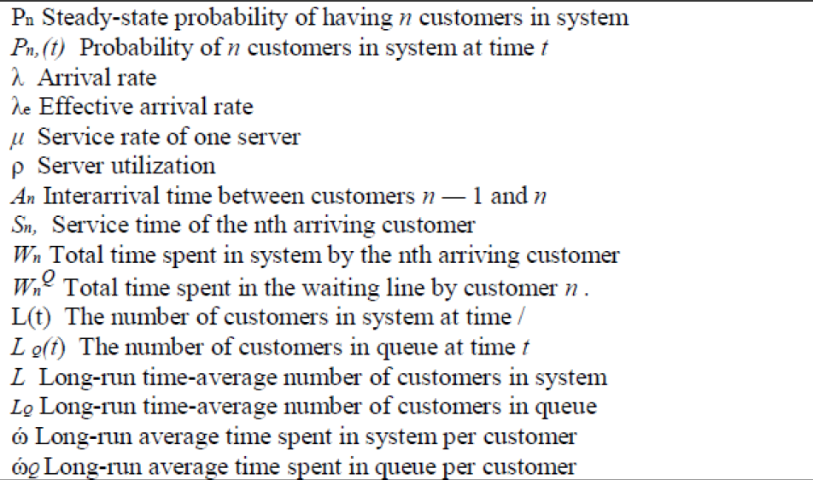
Queuing Notation
Table: Queuing Notation for Parallel Server Systems:

Slide 30
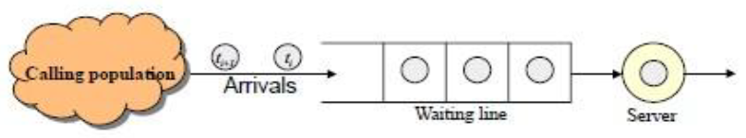
Simulation of queuing system
Queuing system state:
System
Server
Units (in queue or being served)
Clock
State of the system
Number of units in the system
Number of units in the queue
Status of server (idle, busy)
Events
Arrival of a unit
Departure of a unit

Slide 31
Queuing Model
Balking: Balking is a queue behavior wherein people leave as soon as they realize that they will to wait. So if an arrival doesn’t join the system and leave is said to be Balking.
Balking can also be two types
Forced balking
Unforced balking
Retrial or Jockeying Queue:
As the name suggests, this particular queue behavior refer to customers’ response to rejoin a queue that they had left earlier due to balking or reneging.

Slide 32
Queuing Model
Reneging:
Reneging refer to a queue behavior wherein people leave a queue after they are tired of waiting .
Polling:
When there are more than one queue forming (establishing) for same service, the action of sharing service between the queues is called polling.
A bus picking up passengers from different stoppage along its route is an example of polling service.
Separate queue for ladies and gents at ticket window, is another example of polling service.

Slide 33
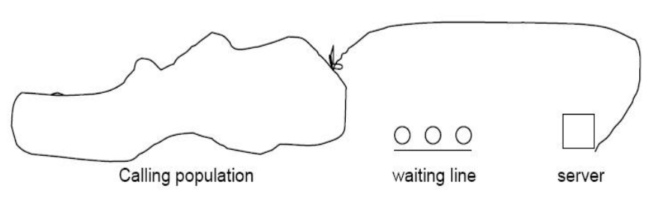
Queuing Model
Single Server Queue
A queuing system is described by its calling population, the nature of arrivals, the service mechanism, system capacity and the queuing discipline.
A single channel queuing system is portrayed in fig below.

Slide 34
Queuing Model
Single Server Queue
So in a single server queue,
Calling population is infinite - Arrival rate does not change
Units are served according to FIFO
Arrivals are defined by the distribution of time between arrivals
Service time are according to distribution
Arrival rate must be less than service rate - Stable system
Otherwise waiting line will grow unbounded -Unstable system (congestion)

Slide 35
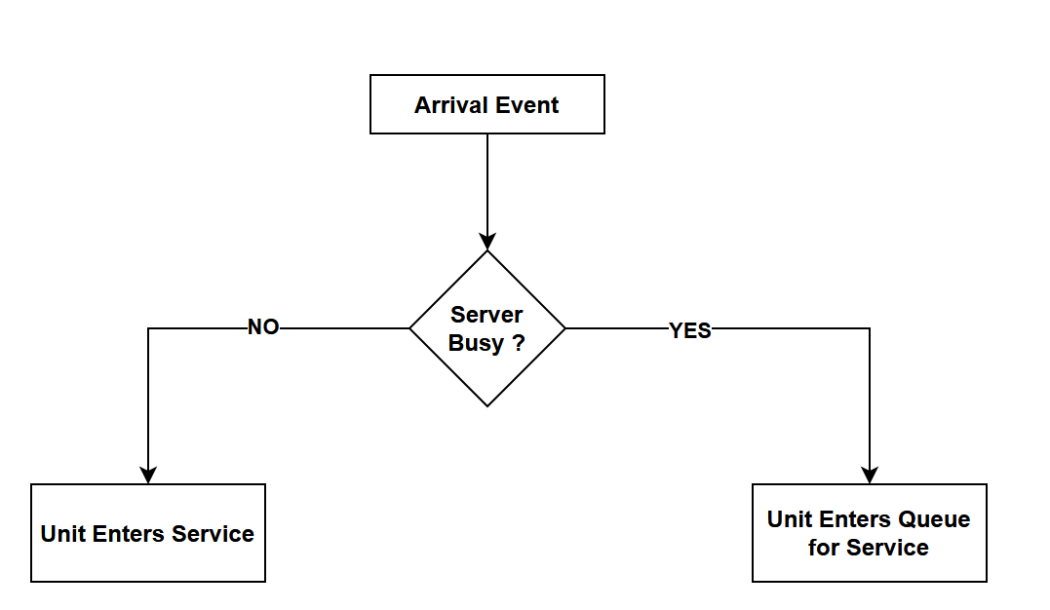
Queuing Model
Arrival Event:
If server is idle, unit gets service, otherwise unit enters queue.
Fig: Unit entering system-flow diagram

Slide 36
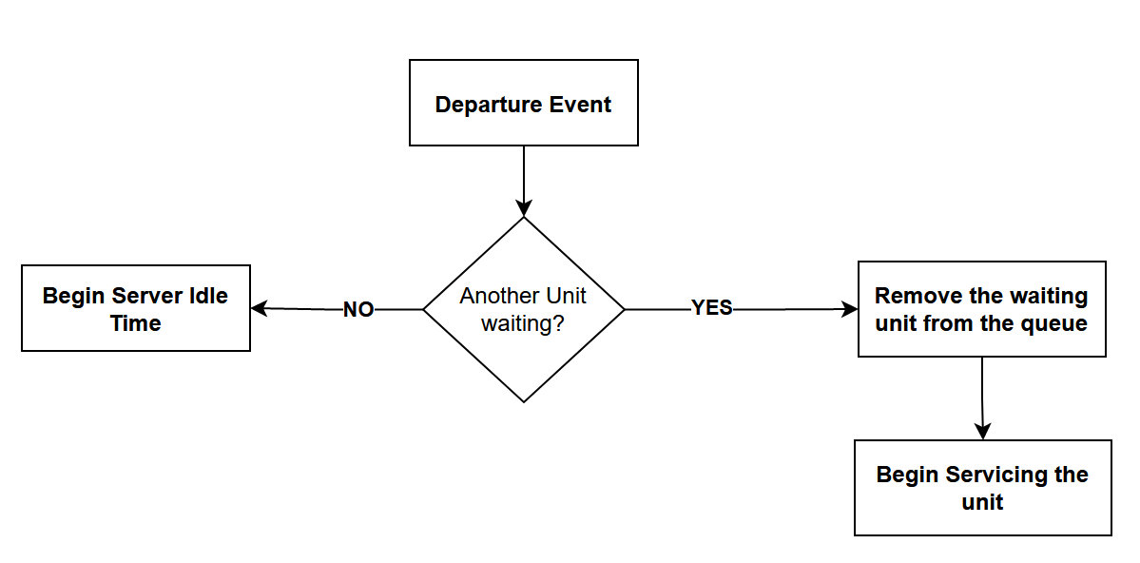
Queuing Model
Departure event:
•If queue is not empty begin servicing next unit, otherwise service will be idle.

Slide 37
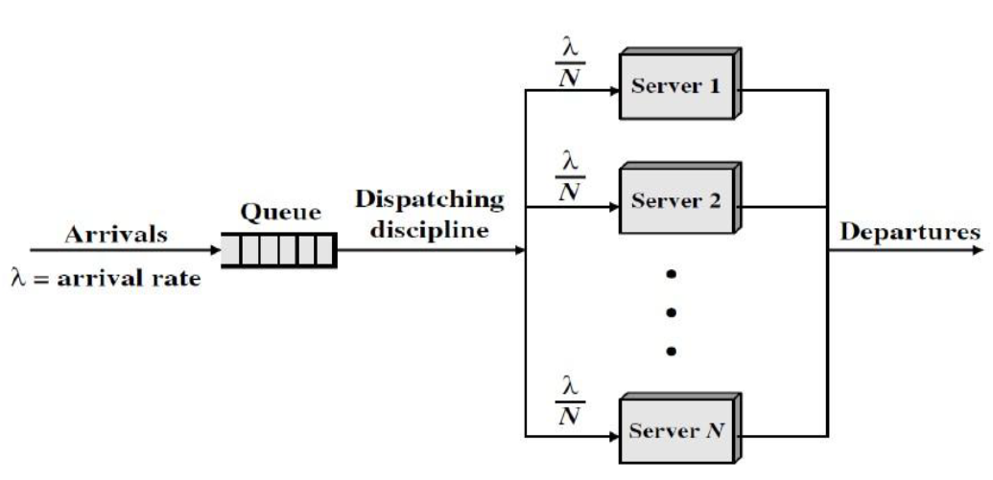
Queuing Model
Multi Server Queue

Slide 38
Queuing Model
Multi Server Queue
Figure shows a generalization of the simple model for multiple servers, all sharing a common queue.
If an unit (customer) arrives and at least one server is available, then the customer will immediately get the service from the specific server.
It is assumed that all servers are identical; thus, if more than one server is available, it makes no difference which server is chosen for the customer.
If all servers are busy, a queue begins to form. As soon as one server becomes free, an item is dispatched from the queue using the dispatching discipline in force.

Slide 39

Queuing Model
Multi Server Queue
Server utilization is the percentage of the time that all servers are busy. It is the ratio between average arrival rate to the average service rate.
The total server utilization in case of Multi-server queue for N server system is
(server utilization)
Where μ is the service rate and λ is the arrival rate.

Slide 40
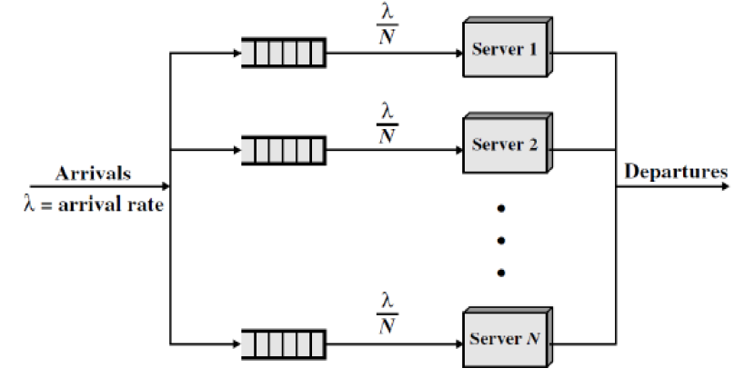
Queuing Model
Multi single Server Queue
There is another concept which is called multiple single server queue system as shown below

Slide 41
Queuing Model
Some notation or Formula used to Measure the different parameter of queue
Two principal measures of queuing system are;
The mean number of customers waiting and
The mean time the customer spend waiting
Both these quantities may refer to the total number of entities in the system, those waiting and those being served or they may refer only to customer in the waiting line.

Slide 42
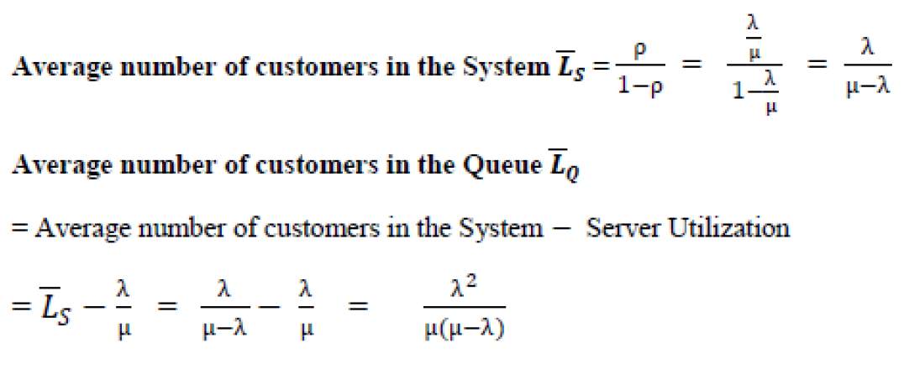
Queuing Model

Slide 43
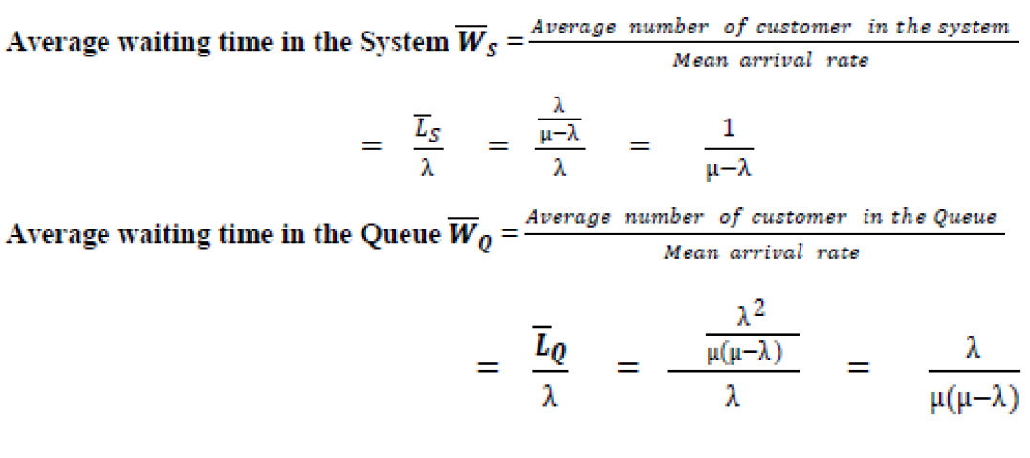
Queuing Model

Slide 44
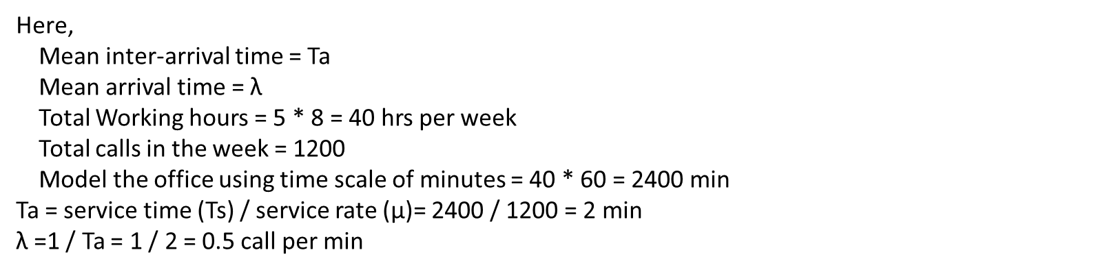
Queuing Model
Example : An office works for 5 days, 8 hours per day, and receives 1200 telephone call in the week. Calculate the mean arrival rate and mean inter-arrival time of the calls.
Here,
Mean inter-arrival time = Ta
Mean arrival time = $\text{λ}$
Total Working hours = 5 * 8 = 40 hrs per week
Total calls in the week = 1200
Model the office using time scale of minutes = 40 * 60 = 2400 min
Ta = service time (Ts) / service rate (μ)= 2400 / 1200 = 2 min
$\text{λ}$=1 / Ta = 1 / 2 = 0.5 call per min

Slide 45
Queuing Model
Q.N > At the ticket counter of football stadium, people come in queue and purchase tickets. Arrival rate of customers is 1/min. It takes at the average 20 seconds to purchase the ticket.
(a) If a sport fan arrives 2 minutes before the game starts and if he takes exactly 1.5 minutes to reach the correct seat after he purchases a ticket, can the sport fan expects to be seated for the kick-off?
Solution:
λ = 1 arrival/min
μ = 3 arrivals/min, Since ticket is disbursed in 20 seconds, this means, three customers enter the stadium per minute, that is service rate is 3 per minute.
𝑾𝑺 = waiting time in the system = 1/( μ- λ)=0.5 minutes
The average time to get the ticket plus the time to reach the correct seat is 1.5 + 0.5 = 2 minutes exactly, so the sports fan can expect to be seated for the kick-off.

Slide 46
Queuing Model
Q.N > At the Bank counter, people come in queue for service. Arrival rate of customers is 2/min. It takes at the average 15 seconds to take service.
(a) If bank will close 2 minutes and if he takes exactly 1 minutes to reach the door, can the customer leave bank in time?
Solution:
λ = 2 arrival/min
μ = 4 arrivals/min
𝑾𝑺 = waiting time in the system=1/( μ- λ)= 1/(4-2) = 0.5 minutes
Now total time will be 1+0.5 = 1.5 minutes.

Slide 47
Queuing Model
Q.N > At the orchid college, student come in queue for service. Arrival rate of customers is 1/min. It takes at the average 22 seconds to take service.
(a) If college will close 3 minutes and if he takes exactly 1.5 minutes to reach the door, can the student leave college in time?
Solution:
λ = 1 arrival/min
μ = 2 arrivals/min
𝑾𝑺 = waiting time in the system=1/( μ- λ)= 1/(2-1) = 1 minutes
Now total time will be 1+1.5 = 2.5 minutes.

Slide 48
Queuing Model
Q.N. > At the Bank, people come in queue . Arrival rate of customers is 1/min. It takes at the average 30 seconds to take the token. If a customer arrives 5 minutes before the bank closed and if he takes exactly 4.5 minutes to reach the correct counter after he take a token, can the customer expects to take banking service?
Solution :
A minute is used as unit of time.
λ = 1 arrival/min
μ = 2 arrivals/min
𝑾𝑺 = waiting time in the system=1/( μ- λ)=1 minutes
if he takes exactly 4.5 minutes to reach the correct counter after he take a token, so bank is closed because 4.5+1=5.5

Slide 49
Queuing Model
Q.N > Customers arrive in a bank according to a Poisson's process with mean inter arrival time of 10 minutes. Customers spend an average of 5 minutes on the single available counter, and leave. (a)What is the probability that a customer will not have to wait at the counter? (b) What is the expected number of customers in the bank? (c)How much time can a customer expect to spend in the bank?
Solution:
We will take an hour as the unit of time. Thus, λ = 6 customers/hour, μ = 12 customers/hour.
The customer will not have to wait if there are no customers in the bank.
Thus, P0 = 1 – λ/μ= 1− 6/12 = 0.5
Expected numbers of customers in the bank are given by
𝑳𝑺 = λ /( μ - λ )=6/6=1
Expected time to be spent in the bank is given by
𝑾𝑺 =1/( μ – λ)= 1/(12-6) = 1/6 hour = 10 minutes.

Slide 50
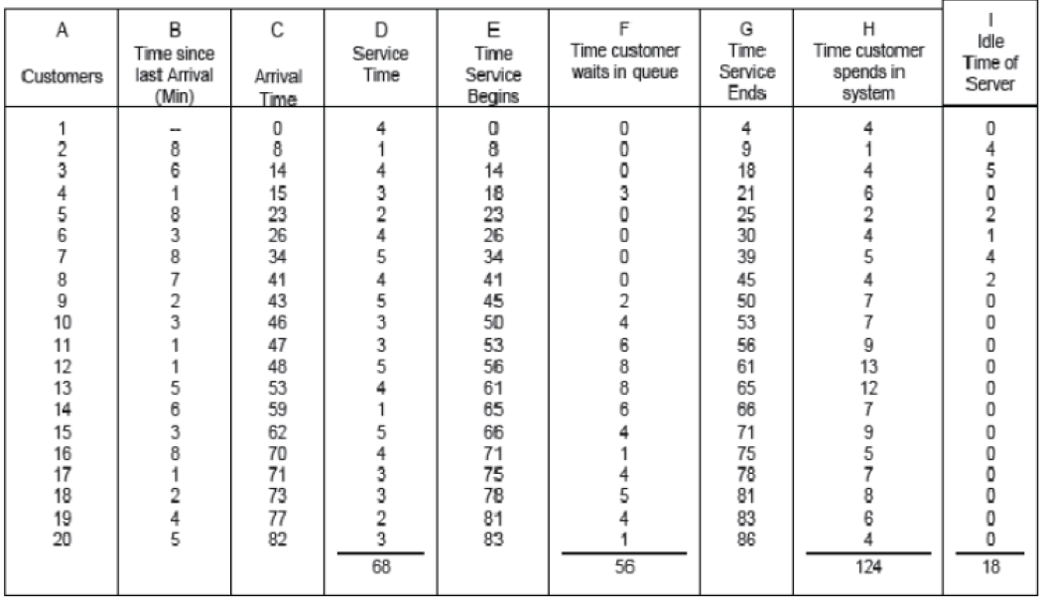
Queuing Model
Find
Average Waiting Time
Probability of wait
Probability of Idle Server
Average Service Time
Notes:
Average Waiting Time = time customer in queue / total number of customers 56/20
Probability of wait = No. of customer who wait / total number of customers 13/20
Probability of Idle Server = Total idle server time / Total run time of simulation 18/86
Average Service Time = total service time / no. of customer 68/20

Slide 51
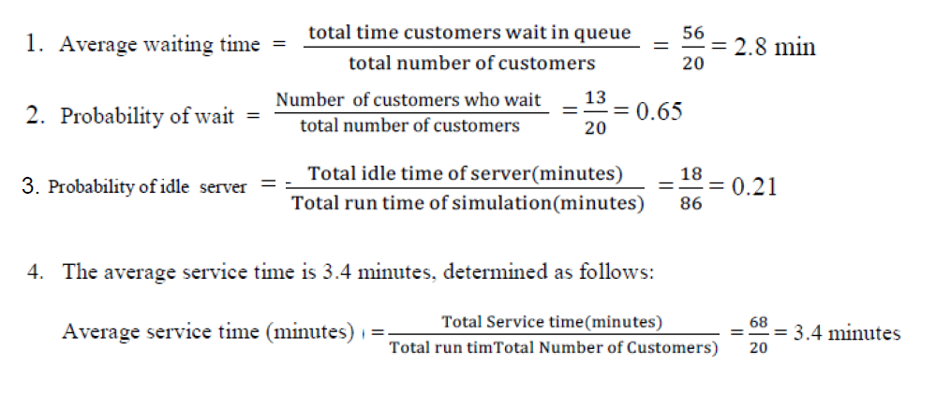
Queuing Model

Slide 52
Measures of System Performance
The performance of a queuing system can be evaluated in terms of a number of response parameters, however the following four are generally employed.
Average number of customer in the queue or in the system
Average waiting time of the customer in the queue or in the system
System utilization (Server utilization)
The cost of waiting time and idle time

Slide 53
Measures of System Performance
Each of these measures has its own importance.
The knowledge of average number of customers in the queue or in the system helps to determine the space requirements of the waiting entities.
Also too long a waiting line may discourage the prospectus customers, while no queue may suggest that service offered is not good quality to attract customers.

Slide 54
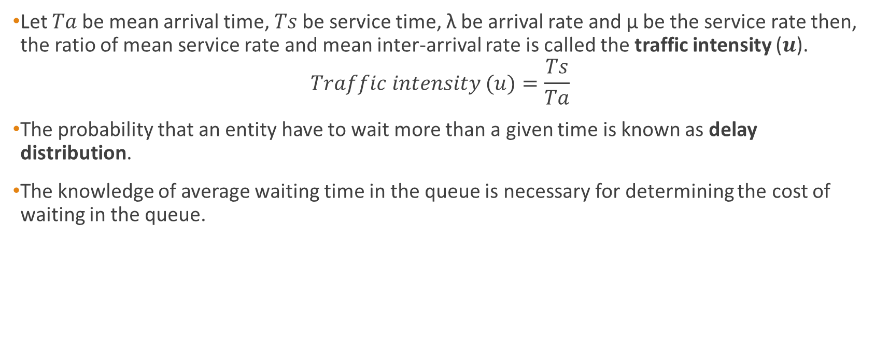
Measures of System Performance
Let 𝑇𝑎 be mean arrival time, 𝑇𝑠 be service time, λ be arrival rate and μ be the service rate then, the ratio of mean service rate and mean inter-arrival rate is called the traffic intensity (𝒖).
$$Traffic intensity (u)=\frac{Ts}{Ta}$$
The probability that an entity have to wait more than a given time is known as delay distribution.
The knowledge of average waiting time in the queue is necessary for determining the cost of waiting in the queue.

Slide 55
Measures of System Performance
System utilization, that is, the percentage capacity utilized reflects the extent to which the facility is busy rather than idle. System utilization factor (p) is the ratio of average arrival rate (λ) to the average service rate (μ).
p = 𝜆 ⁄ 𝜇 , in case of single server model
p = 𝜆 ⁄ 𝑛𝜇 , in case of ‘𝑛’ server model

Slide 56
Application of queuing system:
Telecommunication
Traffic control
Computer process
Manufacturing process

Slide 57
Exercise
What do you mean by Queuing system? Explain the characteristics of Queuing system with example.
Define the queuing system. Explain the elements of queuing system with example.
Define congestion.
What do you mean by server utilization?
What do you mean by multi server queues?
Define queuing discipline. Describe different types of queuing disciplines with example.
What are the Kendall notation of Queuing System?

